Slide 1
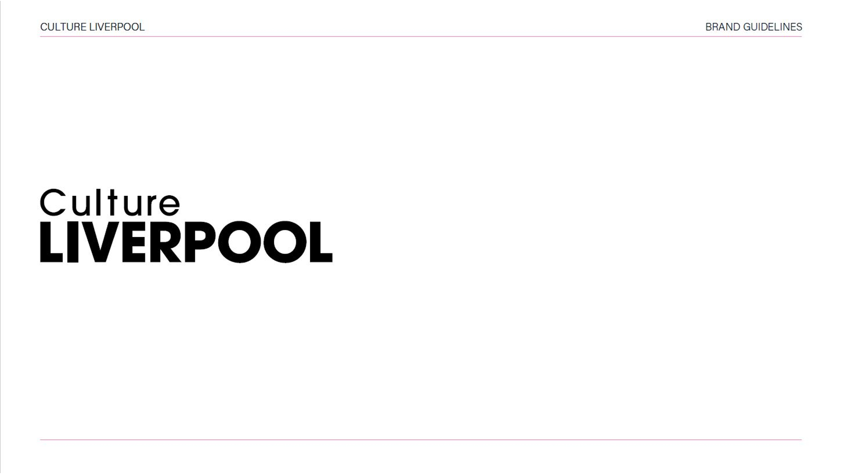

Slide 2
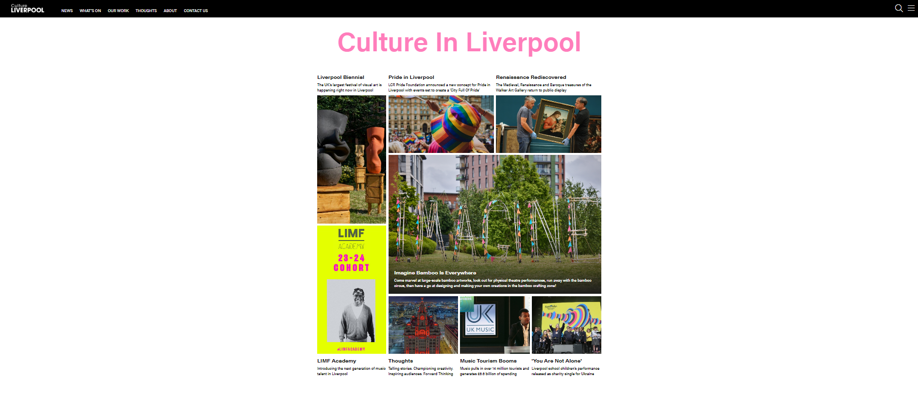
Culture Liverpool home page

Slide 3
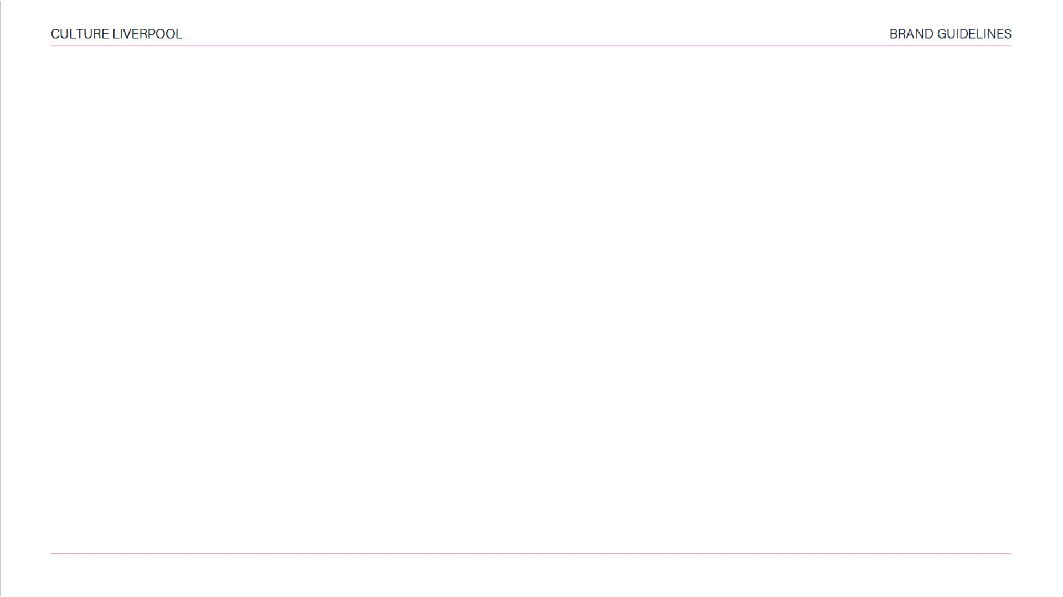
Website guidance 2023
The Culture Liverpool website has recently had a ‘refresh’.
It provides the latest information on the current cultural scene in Liverpool.
It demonstrates how we keep abreast of trends with industry news.
It has a resource of archive material to illustrate how far we have come.
It highlights our solidarity with forward thinking, innovative and cutting-edge cultural partners who join us on our journey to realize the full potential of Liverpool - to be UK’s most exciting city.

Slide 4
Marketing support guidance 2023
The purpose of this document is to draw attention to the new layout and style of the Culture Liverpool website and how partners can be included in:
What’s On Event Listings
Social Media
Press Releases
Opportunities
Blogs
Enewsletter

Slide 5
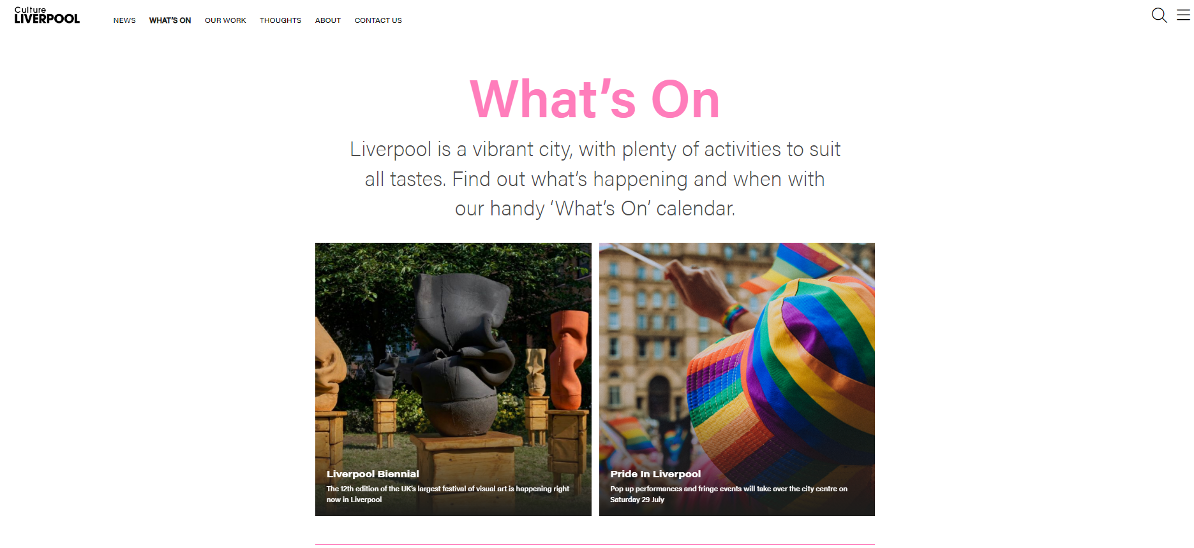
Example of What’s On page

Slide 6
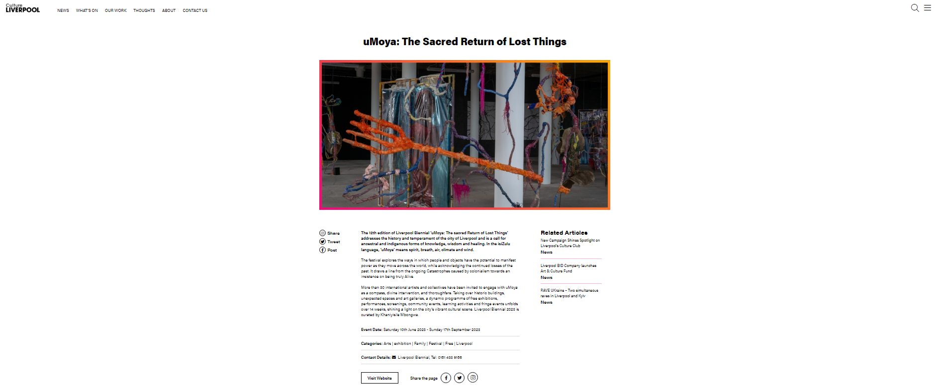
Example of What’s On page

Slide 7
Submit An Event to What’s On page
Keep us informed!
Submit event information to our ‘WHAT’S ON’ page by completing the ‘SUBMIT AN EVENT’ online form.
https://www.cultureliverpool.co.uk/submit-an-event/

Slide 8
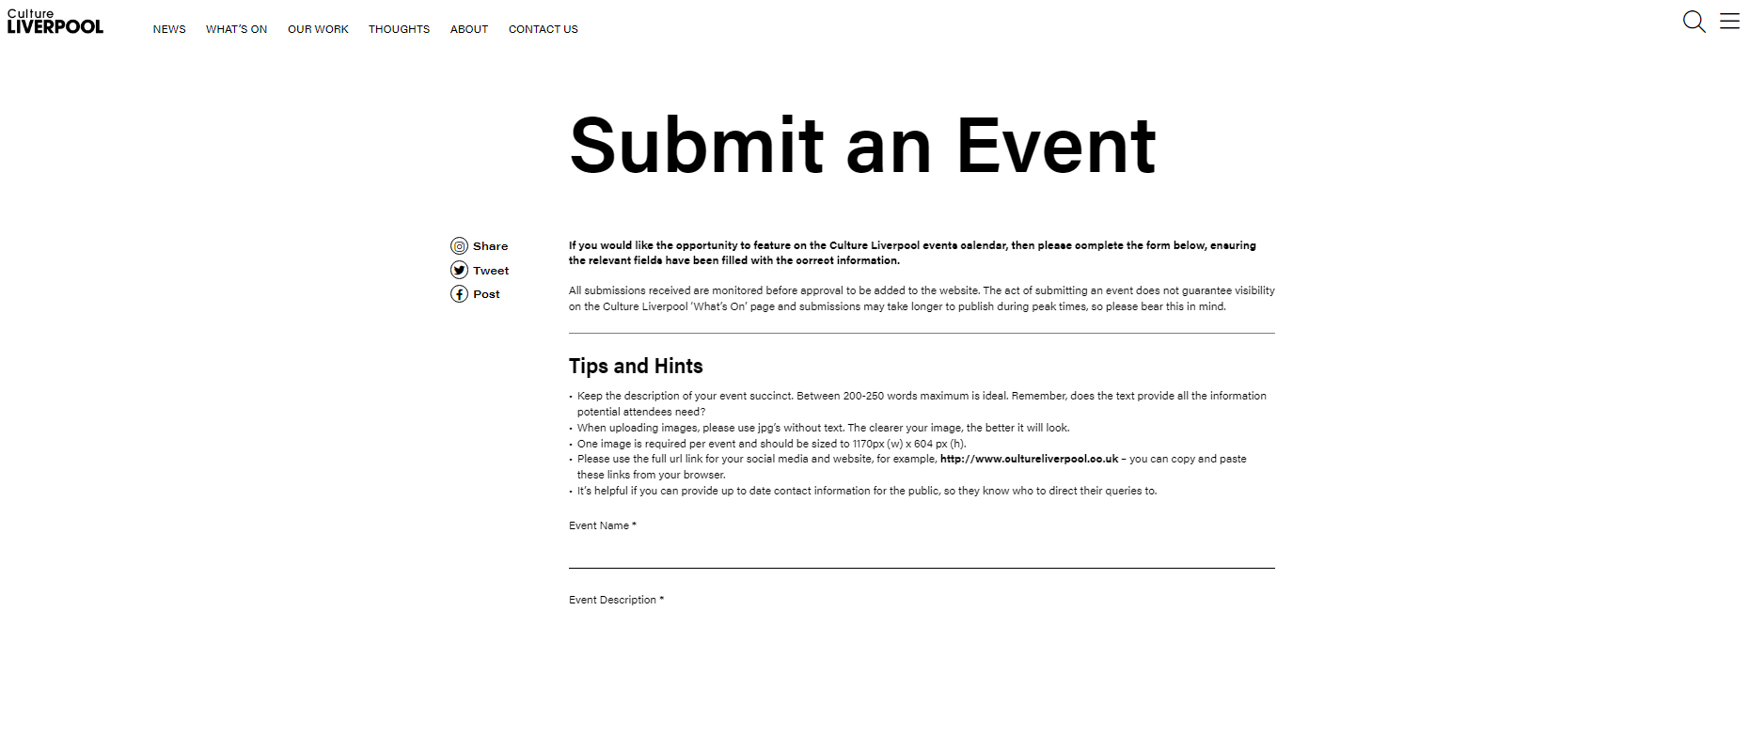
Example of Submit An Event page

Slide 9
Guidance for submissions
SUBMIT the form ensuring ALL fields have been completed.
Text should be succinct and engaging.
ENSURE your text provides relevant information about your event.
ALL event listings require an image: 1170px (w) x 604px (h).
Images should be of a GOOD quality and have no copyright issues.
The act of submitting an event DOES NOT guarantee its publishing.
Allow 5 WORKING DAYS for your event to be listed if approved.

Slide 10
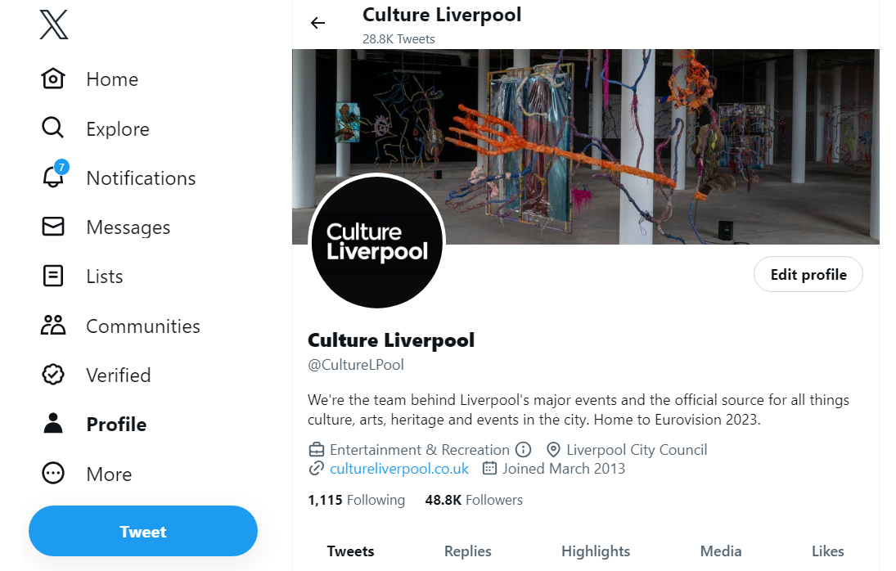
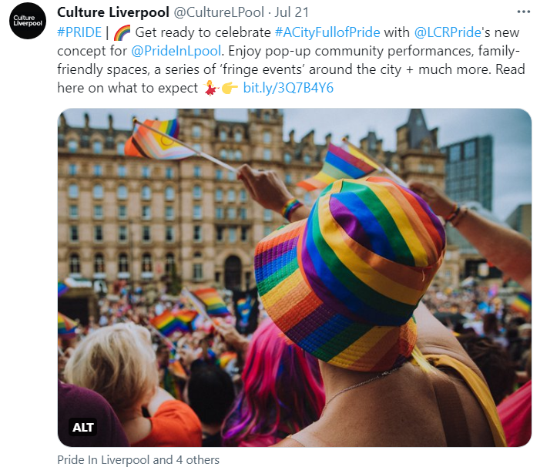
Culture Liverpool’s twitter page

Slide 11




Social Support
Culture Liverpool is currently active across the following platforms:
facebook.com/CultureLiverpool
twitter.com/CultureLPool
instagram.com/culture_liverpool/
linkedin.com/in/culture-liverpool-199491a9/

Slide 12
Guidance for inclusion on socials
Event listings on the Culture Liverpool ‘WHAT’S ON’ page are supported by social media promotion - the best way to receive social support is by submitting an event.
Include social urls on your event listing so we can tag you in on our posts to help amplify messaging.
There is no ‘set time’ for details of your event listing to appear on Culture Liverpool’s socials.
Event listings form part of Culture Liverpool’s wider social media plan.
We will endeavour to ‘push’ messaging about your event in the weeks leading up to its actual date.

Slide 13
Social Support
The earlier you can provide information about your event the better.
We can support messaging on our social channels that sit outside of events.
Tag both LCC and Culture Liverpool in to social media posts where appropriate.
Requests for support outside of events should be emailed for consideration, with at least 3 working days notice.
Email CULTUREMARKETING@LIVERPOOL.GOV.UK with such requests.

Slide 14
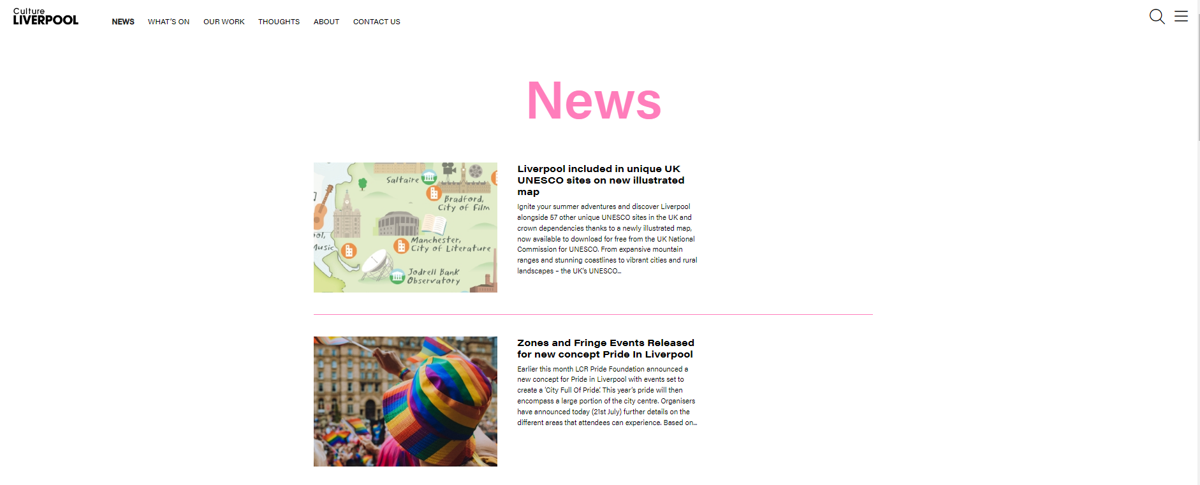
Example of News page

Slide 15
Inclusion on the News page
Submit a Press Release.
Press Releases should include a GOOD quality image which has no copyright issues. Images: 1170px (w) x 604px (h).
The act of submitting a Press Release DOES NOT guarantee its publishing.
Please provide Press Releases with at least 48 hours notice where possible.
ALL Press Releases should be sent to CULTUREMARKETING@LIVERPOOL.GOV.UK for consideration.

Slide 16
Press Release advice
Make sure Liverpool City Council’s support is referenced in all press releases - even if it’s just in a boiler plate.
Consider whether your comms would benefit from a council quote.
At least 48 hours’ notice is helpful.
Tag both LCC and Culture Liverpool in to social media posts where appropriate.
Share photos, videos or blogs.
Does your story link to the council’s best value agenda?
Do you need support/guidance?

Slide 17
Inclusion Opportunities page
Keep us informed!
Submit information to our ‘OPPORTUNITIES’ page by completing the ‘SUBMIT AN OPPORTUNITY’ online form.
https://www.cultureliverpool.co.uk/submit-an-opportunity/

Slide 18
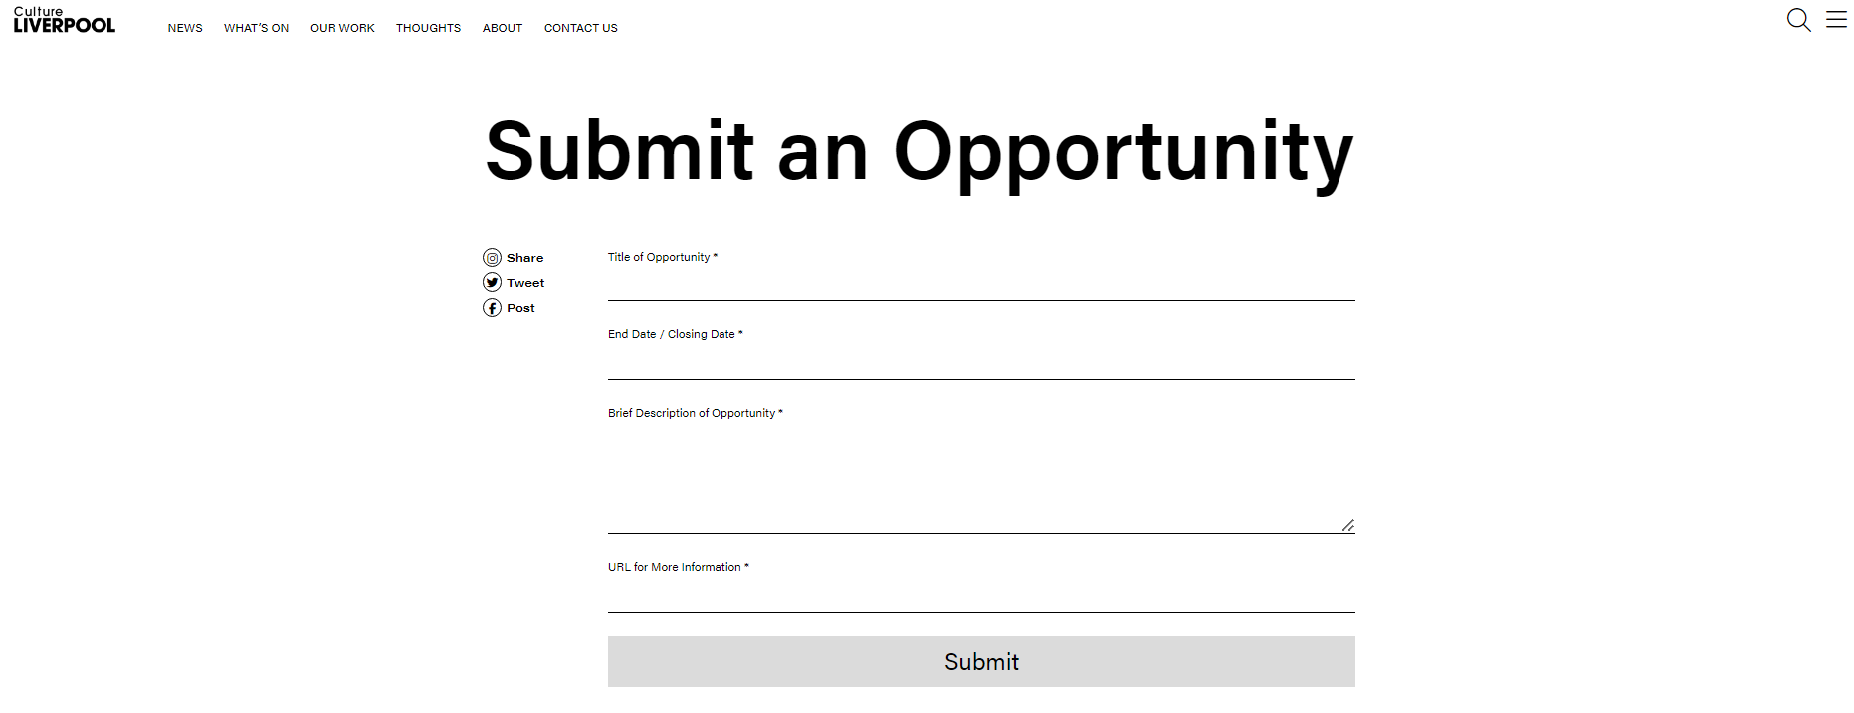
Example of Submit An Opportunity page

Slide 19
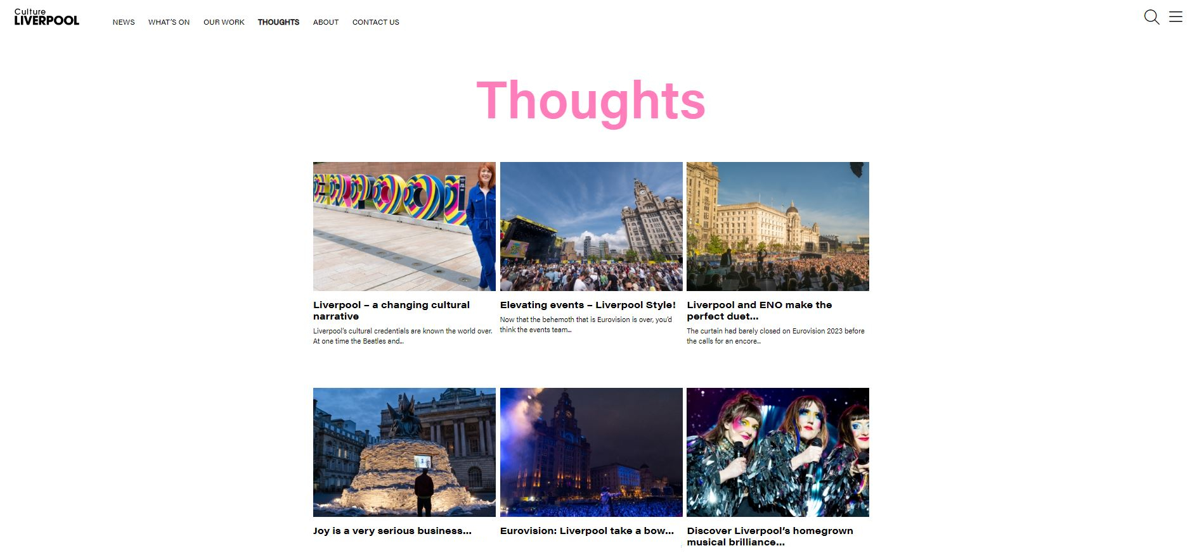
Example of the Thoughts page

Slide 20
Inclusion on Thoughts page
Everyone is invited to submit a blog (thoughts).
Blogs should include a GOOD quality image which has no copyright issues. Images: 1170px (w) x 604px (h).
The act of submitting Blog DOES NOT guarantee its publishing.
Culture Liverpool reserve the right to edit where appropriate.
Please provide Blogs with at least 3 working days notice.
ALL Blogs should be sent to CULTUREMARKETING@LIVERPOOL.GOV.UK for consideration.

Slide 21
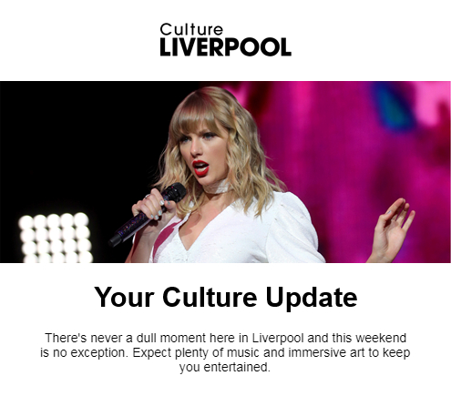
Example of enewsletter

Slide 22
Inclusion in newsletter
Content for the newsletter derives from the WHAT’S ON listing on the Culture Liverpool website.
All CAIP organisations will have the opportunity to feature in Culture Liverpool’s newsletter, which is sent out bi-weekly
Ensure all relevant events are submitted on Culture Liverpool as required for the opportunity to be included.

Slide 23
Brand Guidelines
New edition January 2023.
Queries relating to Culture Liverpool’s branding guidelines should be directed to CULTUREMARKETING@LIVERPOOL.GOV.UK.

Slide 24
Visit Liverpool
Add Visit Liverpool to your press distribution lists so they can keep up to date with your activities.
Let Visit Liverpool know what activities you have planned around major events, like River of Light, music events, food and drink offering, Christmas, Bank Holiday’s so they can provide an extensive and cohesive offer.
Advise whether you are open to press visits at your venues/events.
Queries to be directed to SSHIELDS@MARKETINGLIVERPOOL.CO.UK.

Slide 25
Liverpool City Council
Add Liverpool City Council to your press distribution lists so they can keep up to date with your activities.
Queries to be directed to SARAH.LATCHAM@LIVERPOOL.GOV.UK.

Slide 26
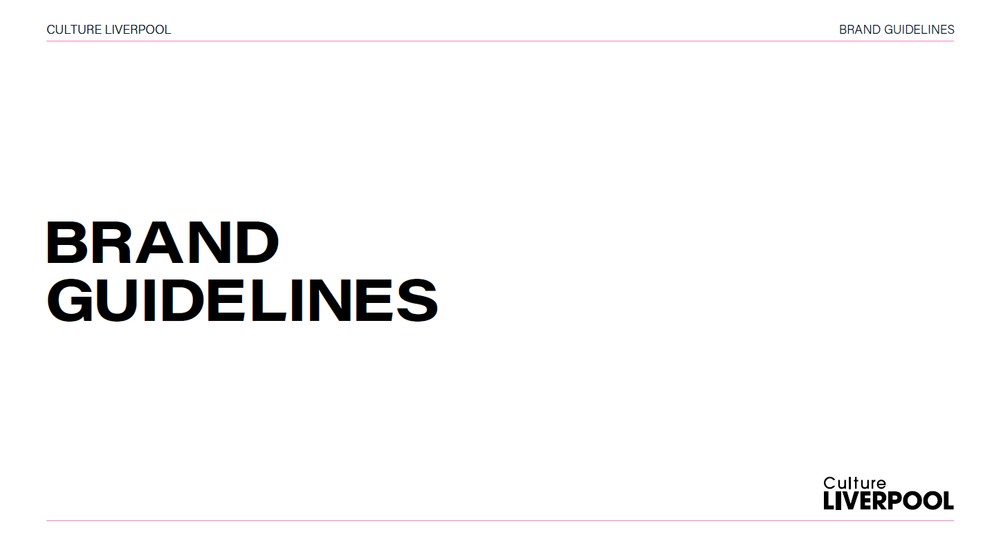

Slide 27
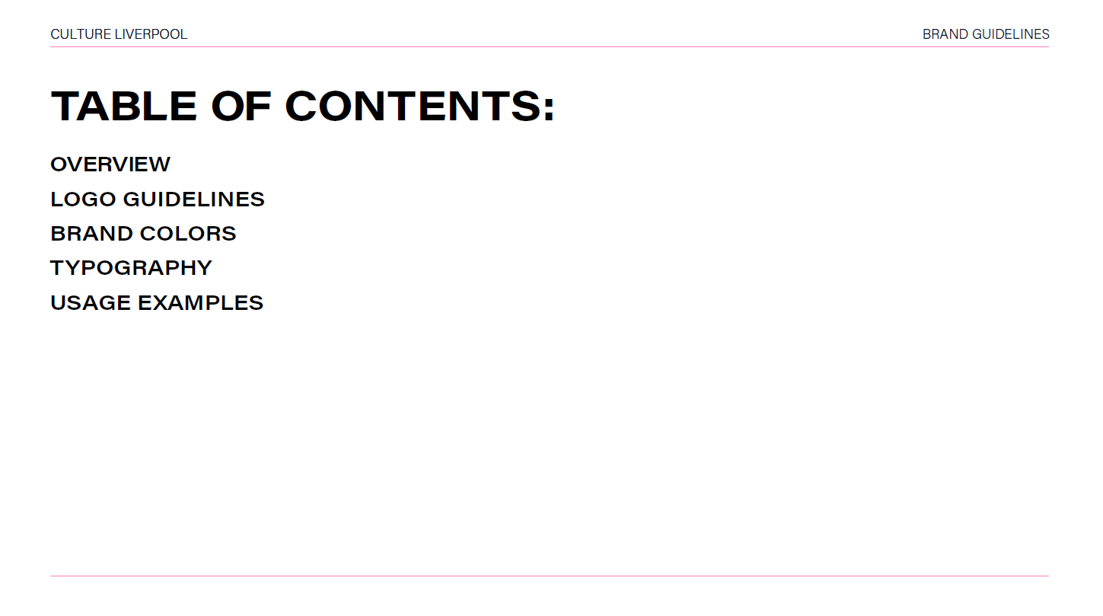

Slide 28
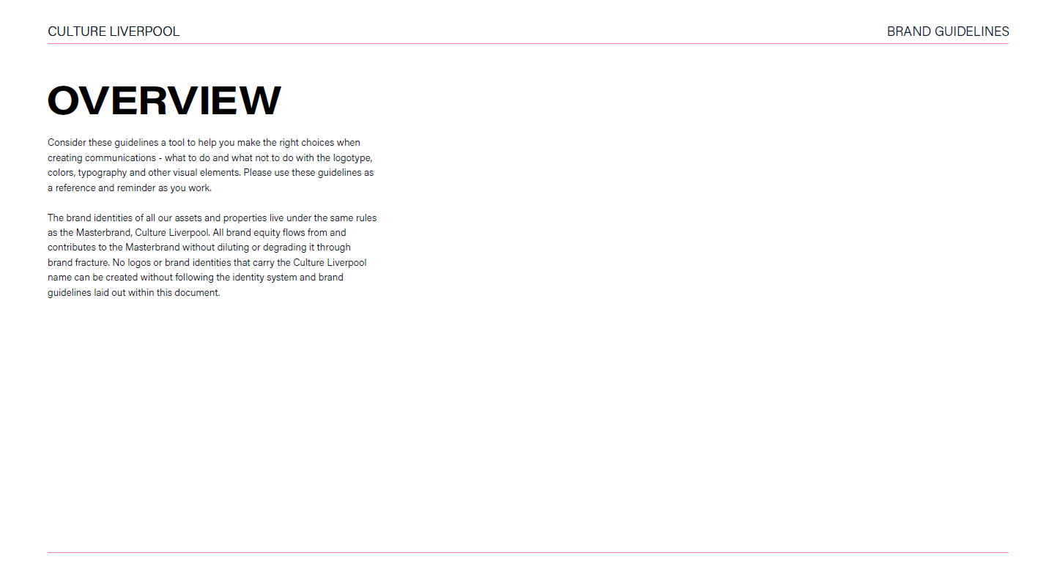

Slide 29
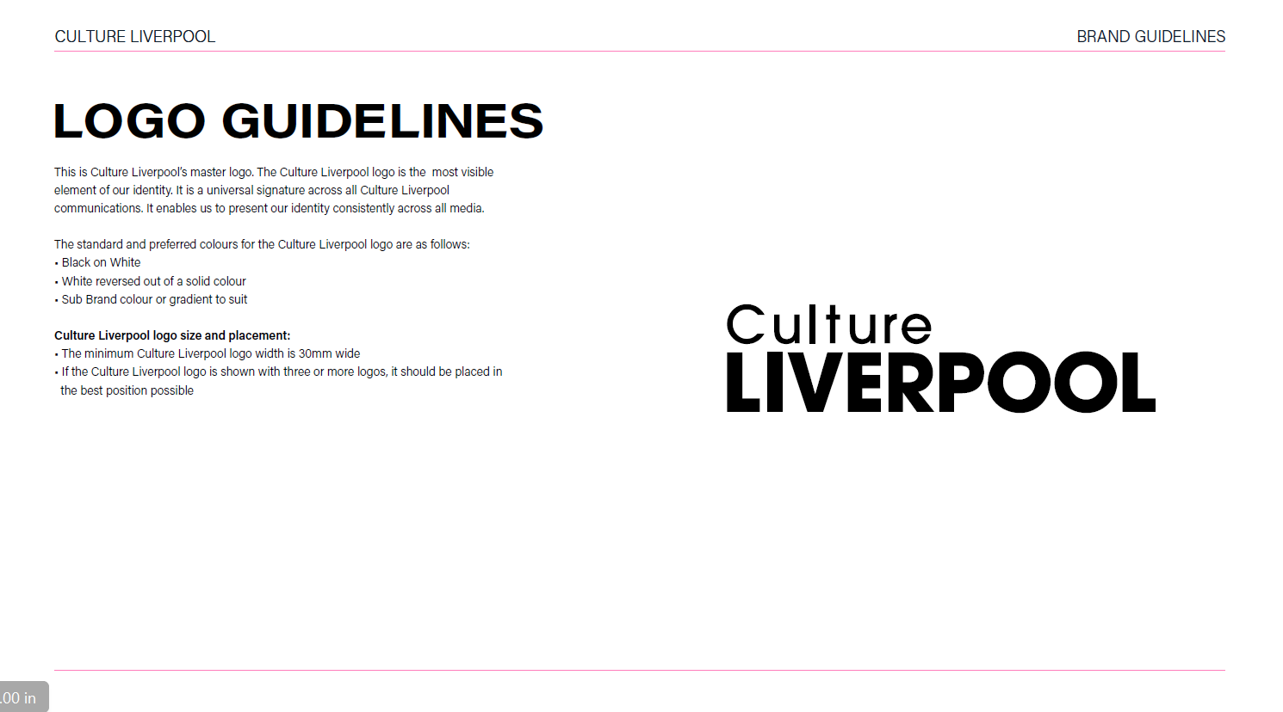

Slide 30
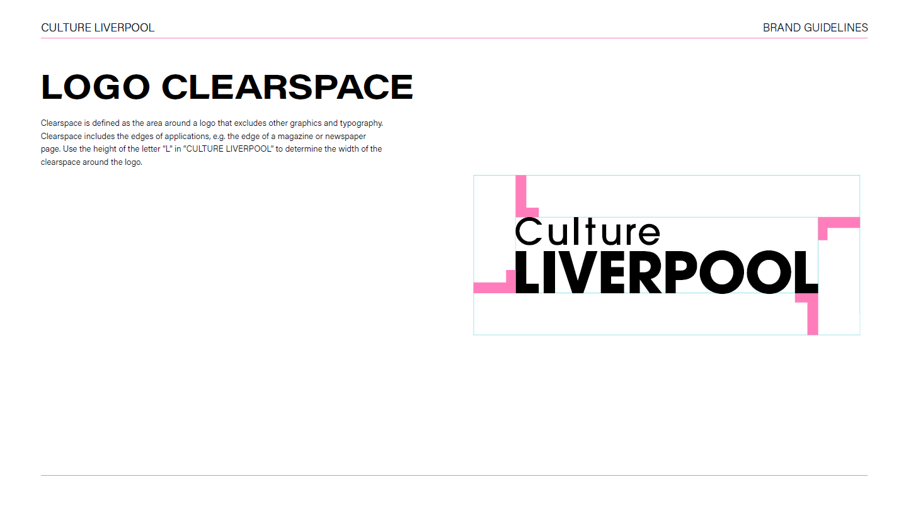

Slide 31
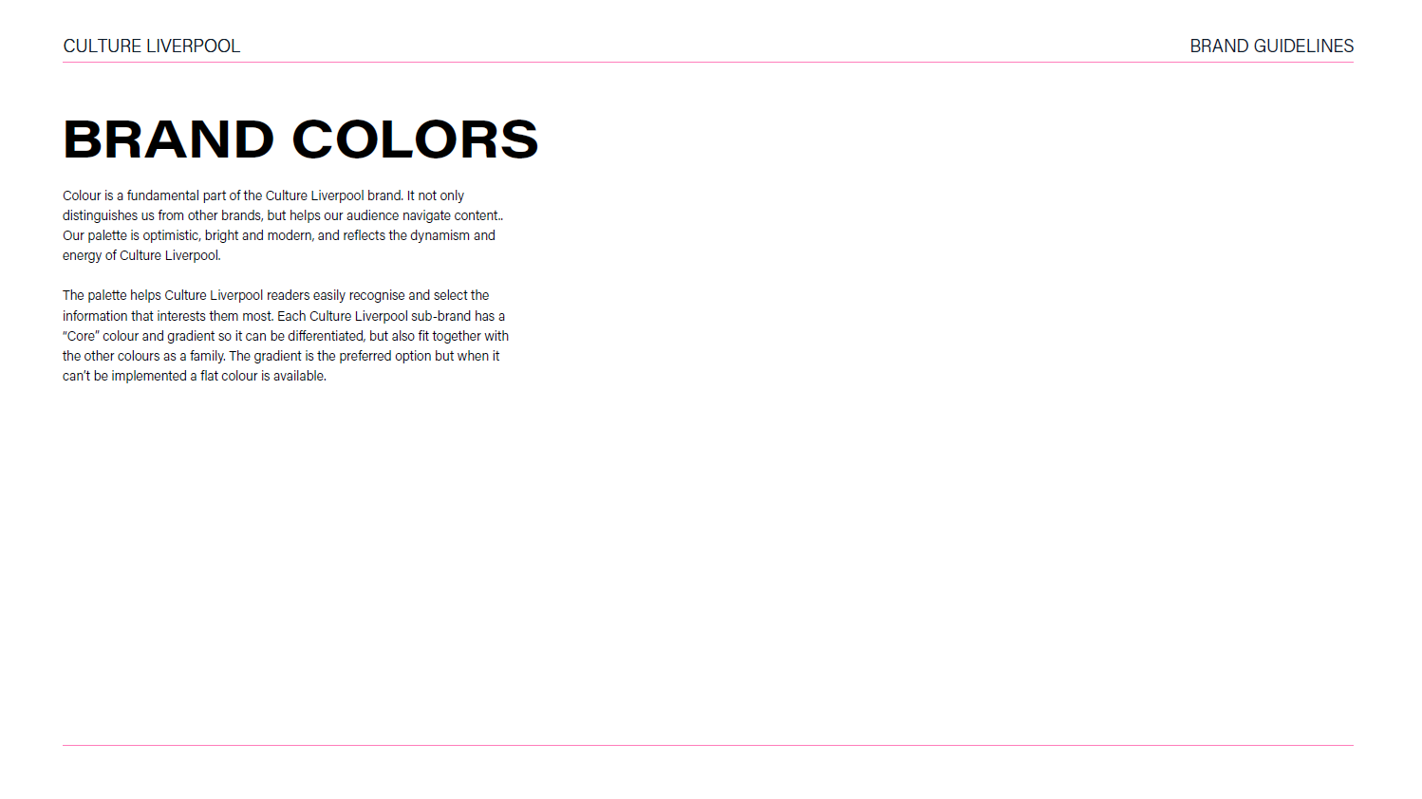

Slide 32
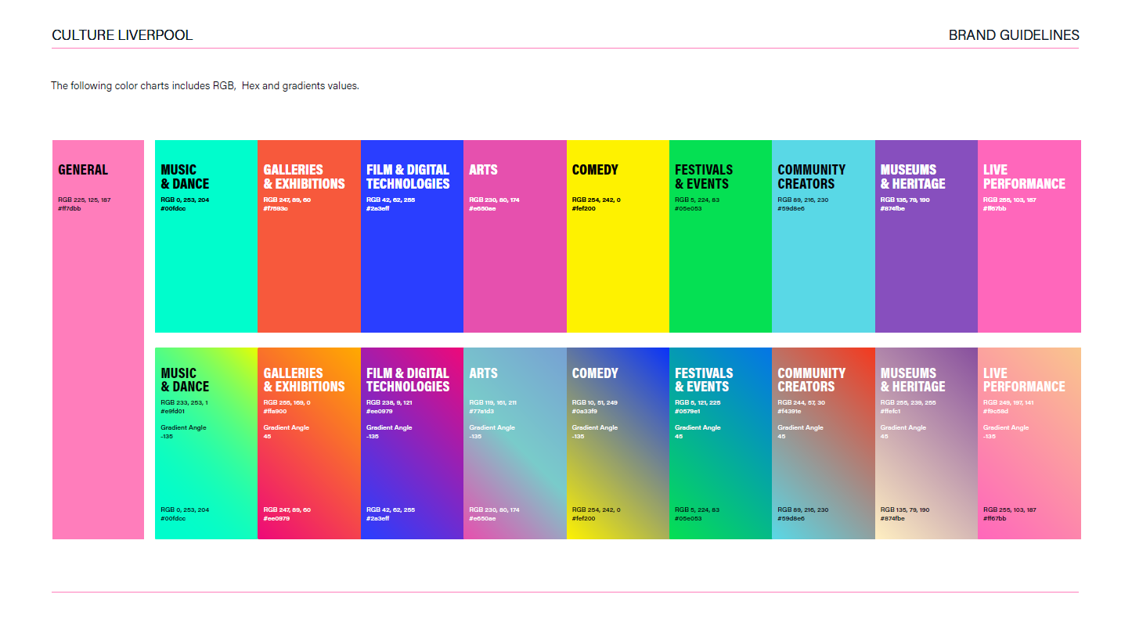

Slide 33
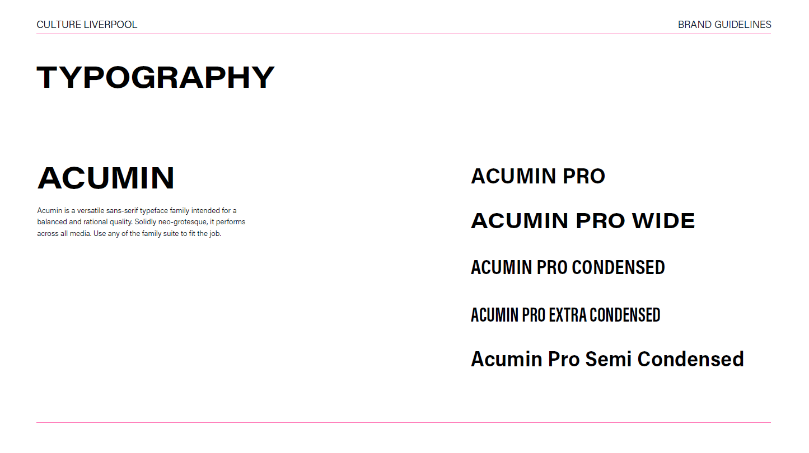

Slide 34
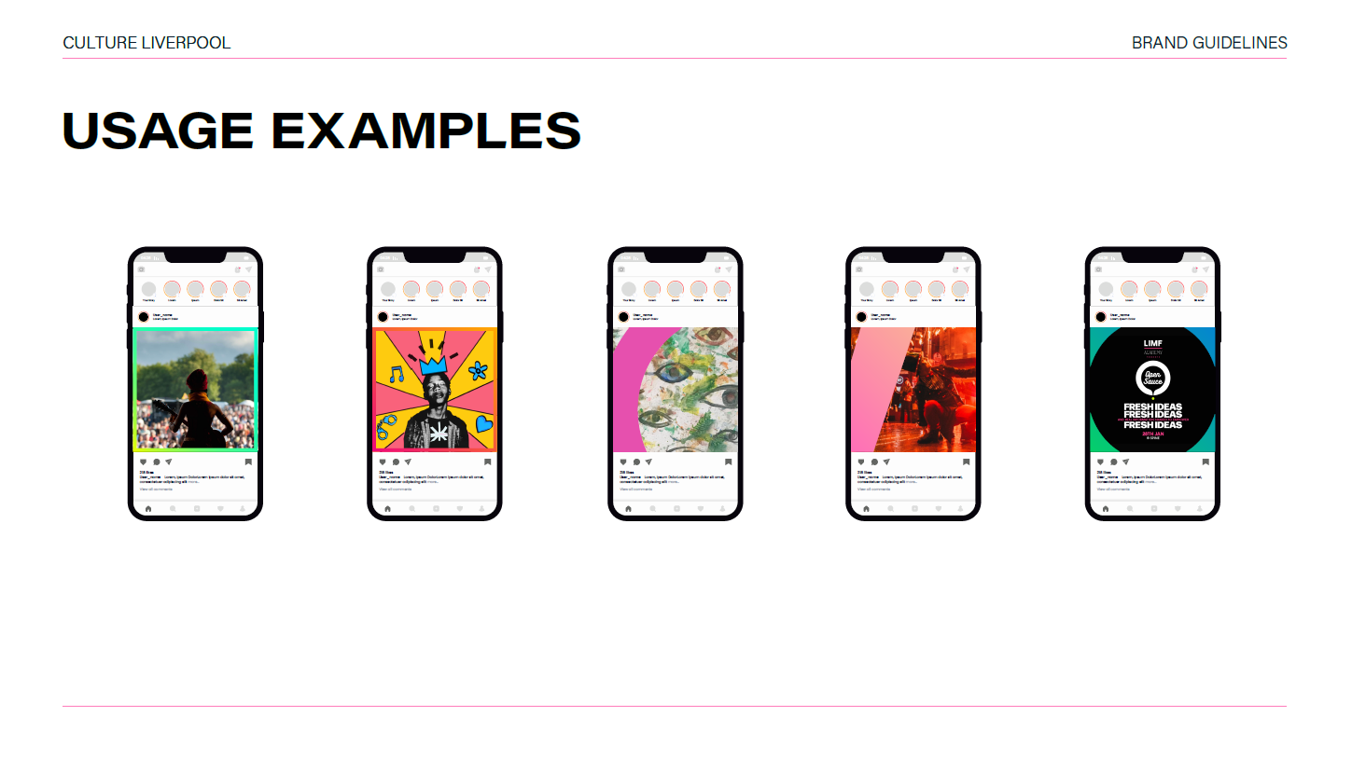

Slide 35
